Slide 1
PREDICTING LISBON HOUSE PRICES
Julia Przybytniowska, Hubert Ruczyński, Kacper Skonieczka

Slide 2
Problem Description
„The main purpose of our study is to analyze the estate situation in Lisbon and provide responsible and explainable models for the task of price estimation.”

Slide 3
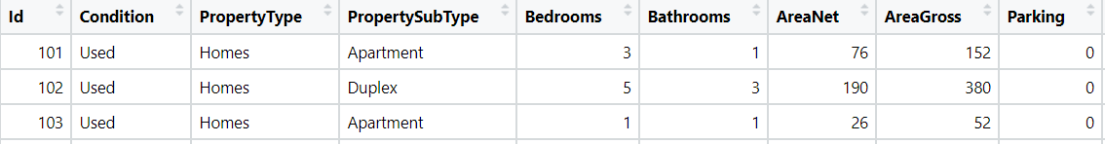
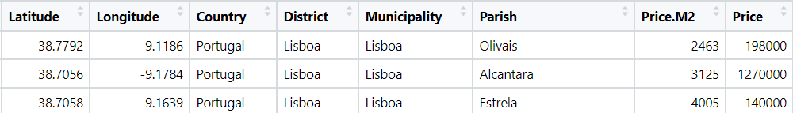
Data Set : Lisbon House Prices
250 observations
17 columns
No NULL values

Slide 4
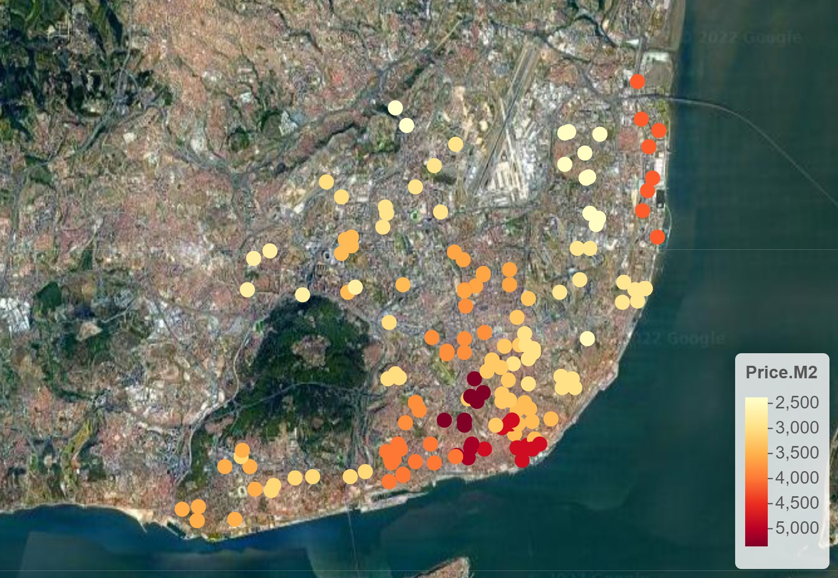
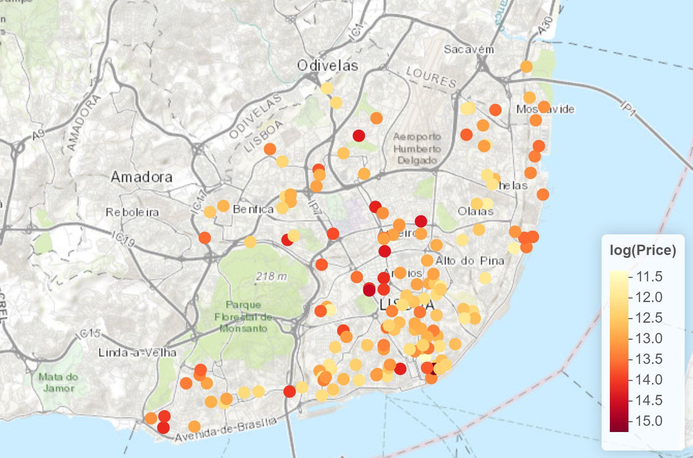
EDA – House Distribution

Slide 5
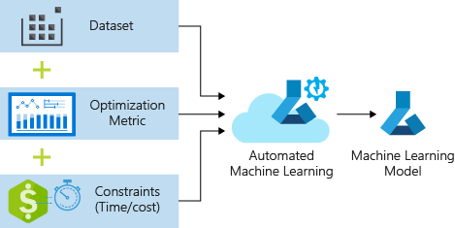
AutoML
Preparation of overlay for Random Forest model with:
Data preprocessing
Quick model creation
Model evaluation
Other groups models: xgboost, lightgbm, catboost
Overlay repository link: https://github.com/MI2-Education/2022L-WB-ML-1/tree/main/milestones/ms2b/deepRession/RandomForestDeepRession

Slide 6
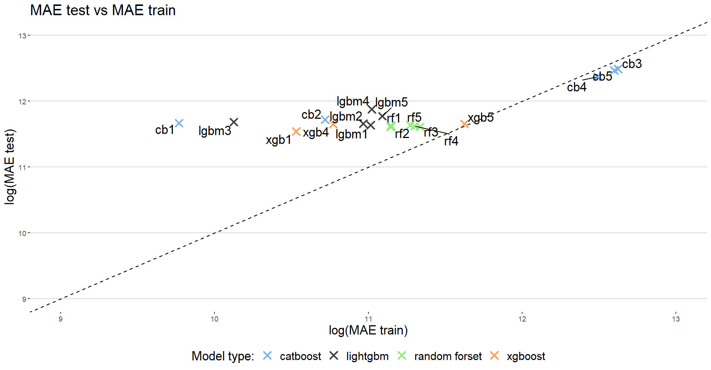
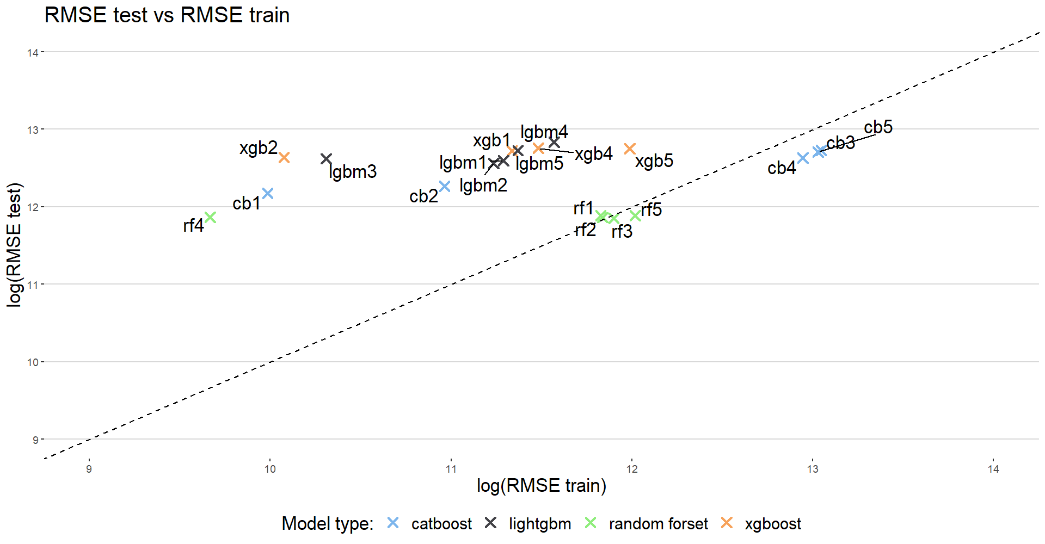
Models

Slide 7
Models

Slide 8
Models

Slide 9
Best Models
Data set mean price: 550 000
Data set median price: 450 000
Model name | RMSE train | RMSE test | MAE train | MAE test
Random Forest 3 | 147210 | 140305 | 83805 | 110186
Xgboost 5 | 160925 | 344837 | 111682 | 115334

Slide 10
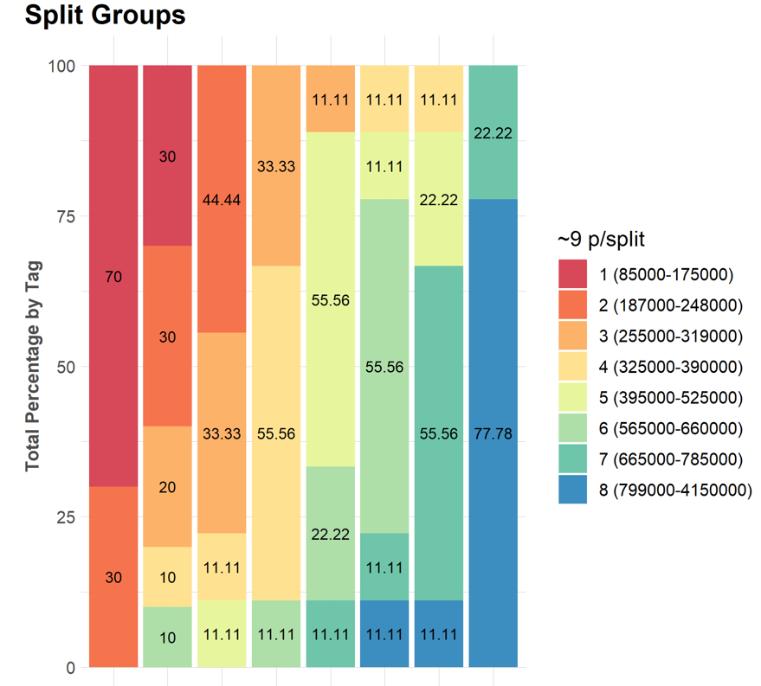
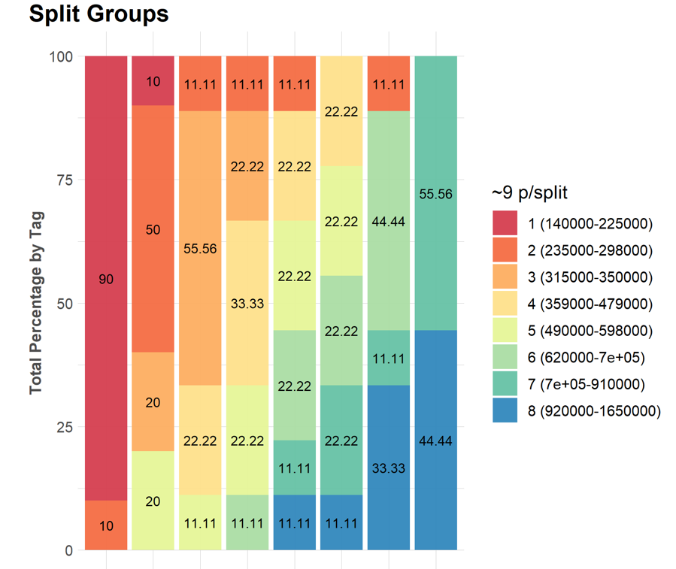
Best Models Split Groups

Slide 11
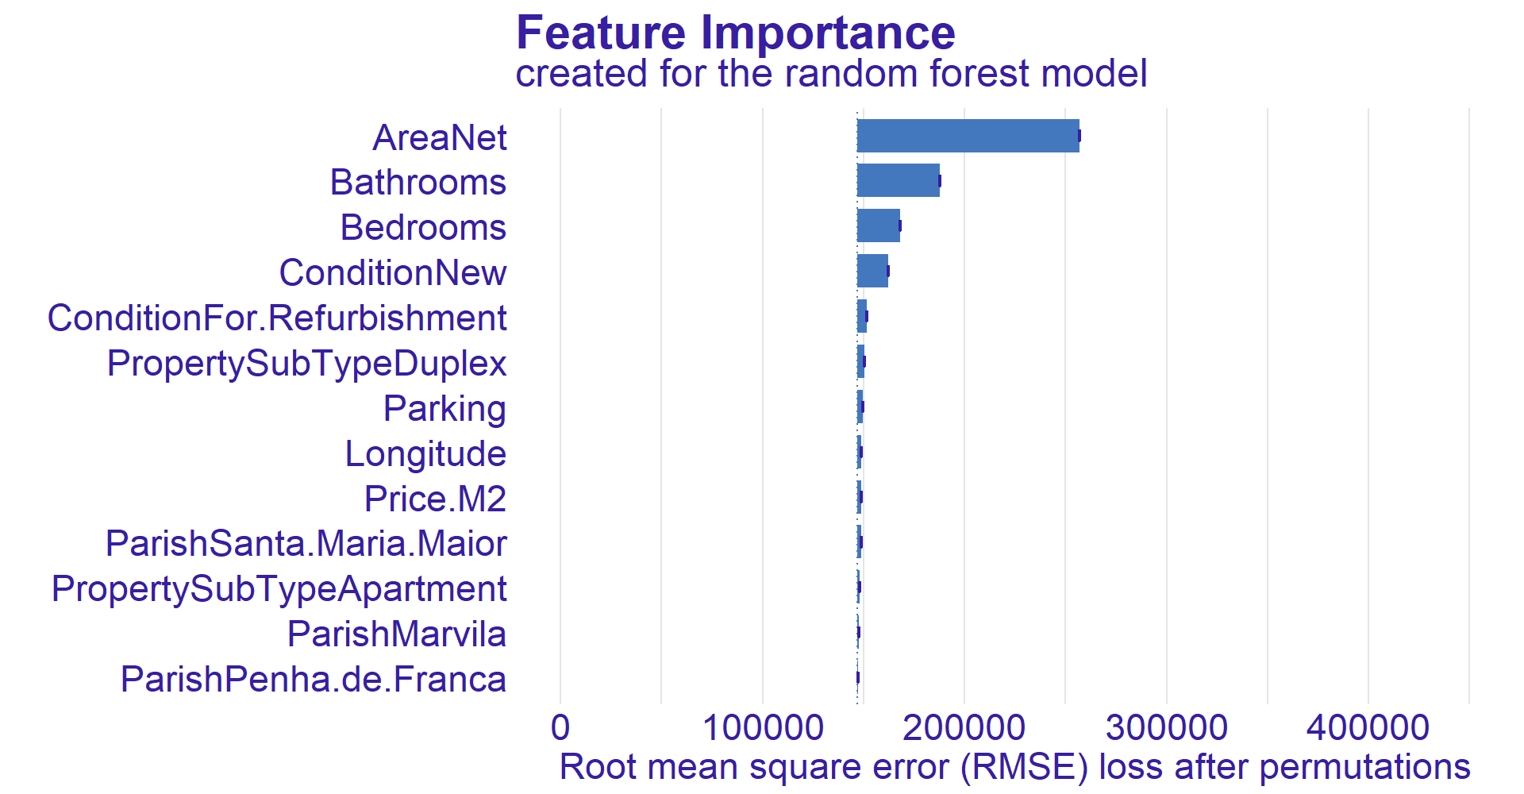
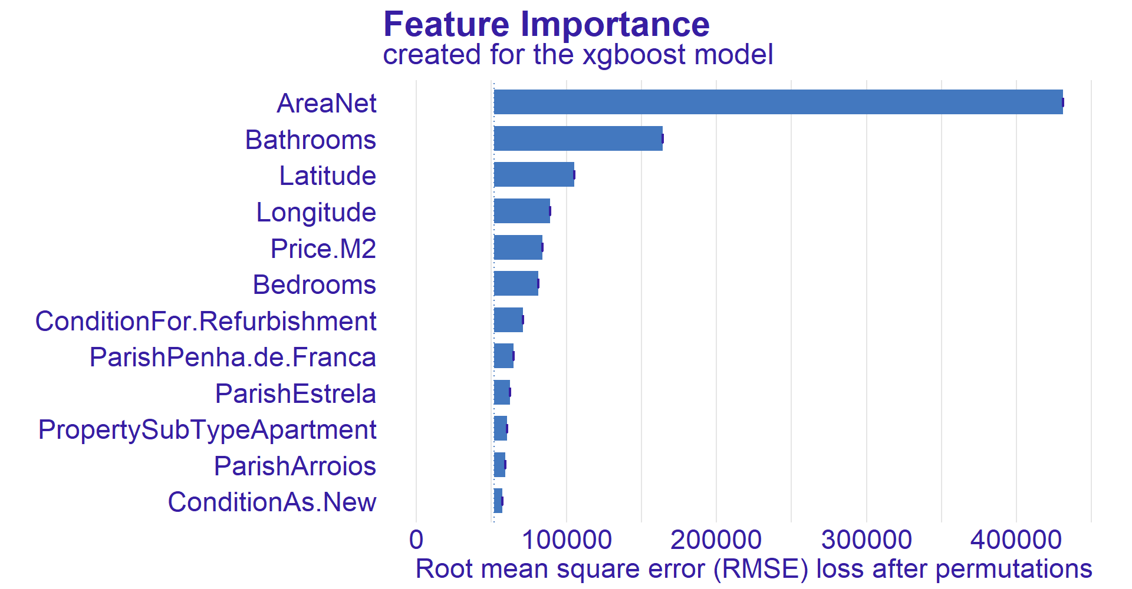
XAI – Feature Importance

Slide 12
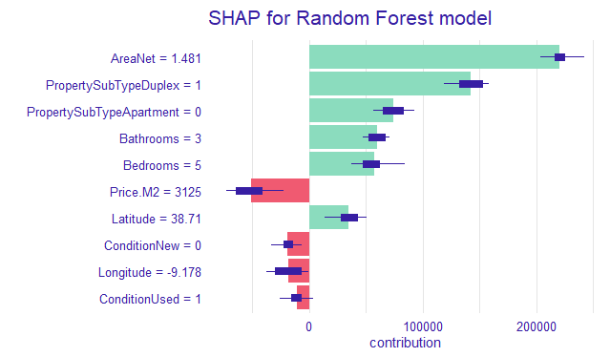
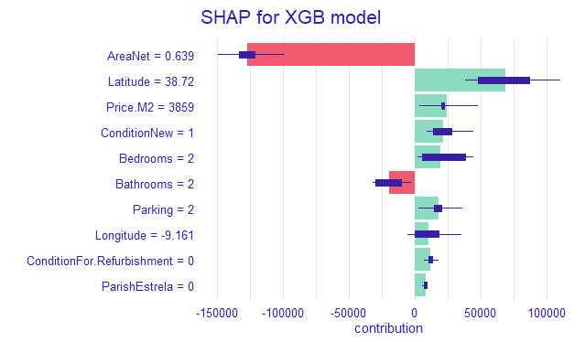
XAI -SHAP

Slide 13
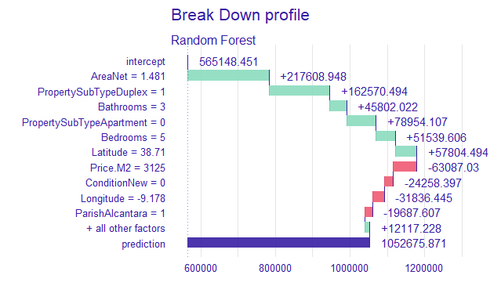
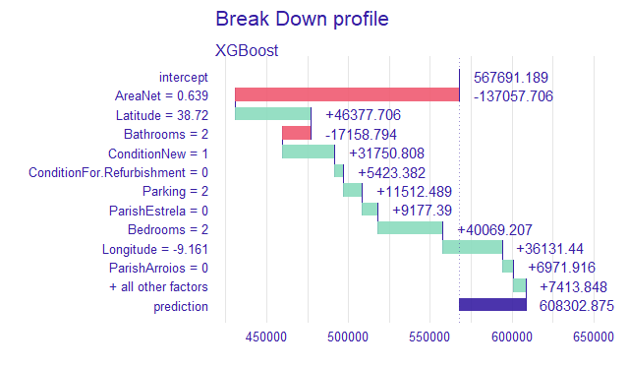
XAI – Break Down

Slide 14
Summary
Creation of Random Forest overlay
Model training with Bayesian optimization
Model selection via RMSE, MAE and Split Groups plots
XAI methods and EDA led to a thorough problem understanding

